Slide 1

NT101-Network Security
Week 03 Computer Networking: a review
Ngoc-Tu Nguyen, PhD
tunn@uit.edu.vn

Slide 2
Outline
Motivations
Protocol layers
Vulnerabilities
Expoint and attacks
Generic countermeasures

Slide 3

The Internet

Slide 4












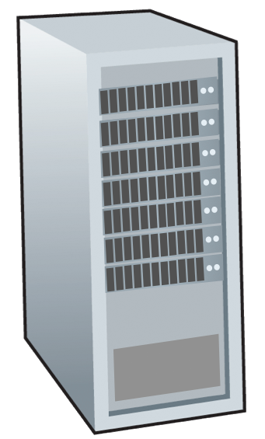

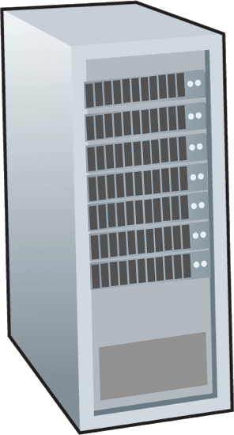


















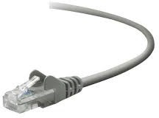









The Internet: the network of networks
Billions of connected computing devices:
hosts = end systems
running network apps at Internet’s “edge”
Packet switches: forward packets (chunks of data)
routers, switches
Communication links
fiber, copper, radio, satellite
transmission rate: bandwidth
Networks
collection of devices, routers, links: managed by an organization
mobile network
na
P
local or regional ISP
Internet
home network
co pro
netwo
er
enterprise
network

Slide 5


The Internet: network of networks
mobile network _{4G}
Internet: “network of networks”
Interconnected ISPs
na
P
protocols are everywhere
control sending, receiving of messages
e.g., HTTP (Web), streaming video, Skype, TCP, IP, WiFi, 4G, Ethernet
Internet standards
RFC: Request for Comments
IETF: Internet Engineering Task Force
Streaming video
Skype
IP
local or regional ISP
home network
co pro
netwo
HTTP
Ethernet
er
TCP
enterprise
network
WiFi

Slide 6
The Internet: a “services” view
Infrastructure that provides services to applications:
Web, streaming video, multimedia teleconferencing, email, games, e- commerce, social media, inter- connected appliances, …
provides programming interface
to distributed applications:
“hooks” allowing sending/receiving apps to “connect” to, use Internet transport service
provides service options, analogous to postal service
mobile network
na
P
Streaming video
Skype
local or regional ISP
home network
co pro
netwo
HTTP
er
enterprise
network

Slide 7
Internet history
2005-present: scale, SDN, mobility, cloud
aggressive deployment of broadband home access (10-100’s Mbps)
2008: software-defined networking (SDN)
increasing ubiquity of high-speed wireless access: 4G/5G, WiFi
service providers (Google, FB, Microsoft) create their own networks
bypass commercial Internet to connect “close” to end user, providing
“instantaneous” access to social media, search, video content, …
enterprises run their services in “cloud” (e.g., Amazon Web Services, Microsoft Azure)
rise of smartphones: more mobile than fixed devices on Internet (2017)
~18B devices attached to Internet (2017)

Slide 8







A closer look at Internet structure
mobile network
na P
local or regional ISP
home network _{co}
pro
netwo _{er}
enterprise
network
Network edge:
hosts: clients and servers
servers often in data centers

Slide 9



A closer look at Internet structure
mobile network
na P
local or regional ISP
home network _{co}
pro
netwo _{er}
enterprise
network
Network edge:
▪ hosts: clients and servers
▪ servers often in data centers
Access networks, physical media:
edge router
wired, wireless communication links

Slide 10
A closer look at Internet structure
mobile network
Network edge:
▪ hosts: clients and servers
▪ servers often in data centers
Access networks, physical media:
▪wired, wireless communication links
na
P
local or regional ISP
home network
co pro
netwo
Network core:
interconnected routers
network of networks
er
enterprise
network

Slide 11









Two key network-core functions
Forwarding:
aka “switching”
Routing:
global action: determine source- destination paths taken by packets
routing algorithms
routing algorithm
local forwarding table
header value | output link
0100 | 3
0101 | 2
0111 | 2
1001 | 1
local forwarding table
local action: move arriving packets from router’s input link to appropriate
router output link
1
3
2
0111
destination address in arriving packet’s header

Slide 12
routing

Slide 13

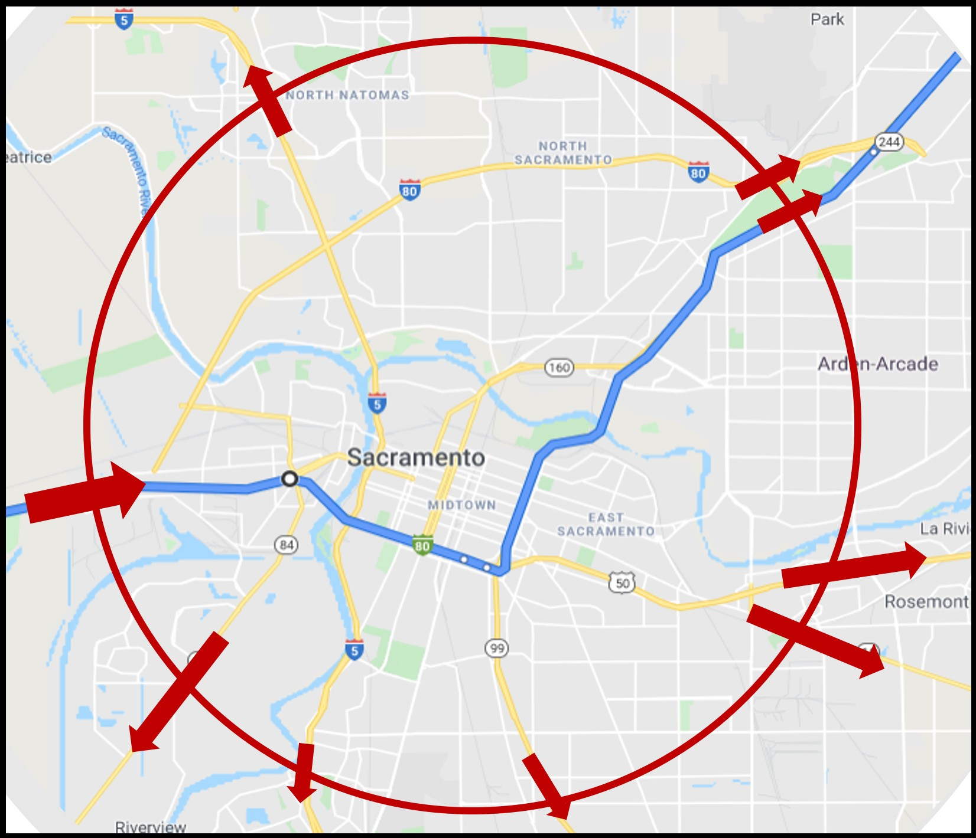

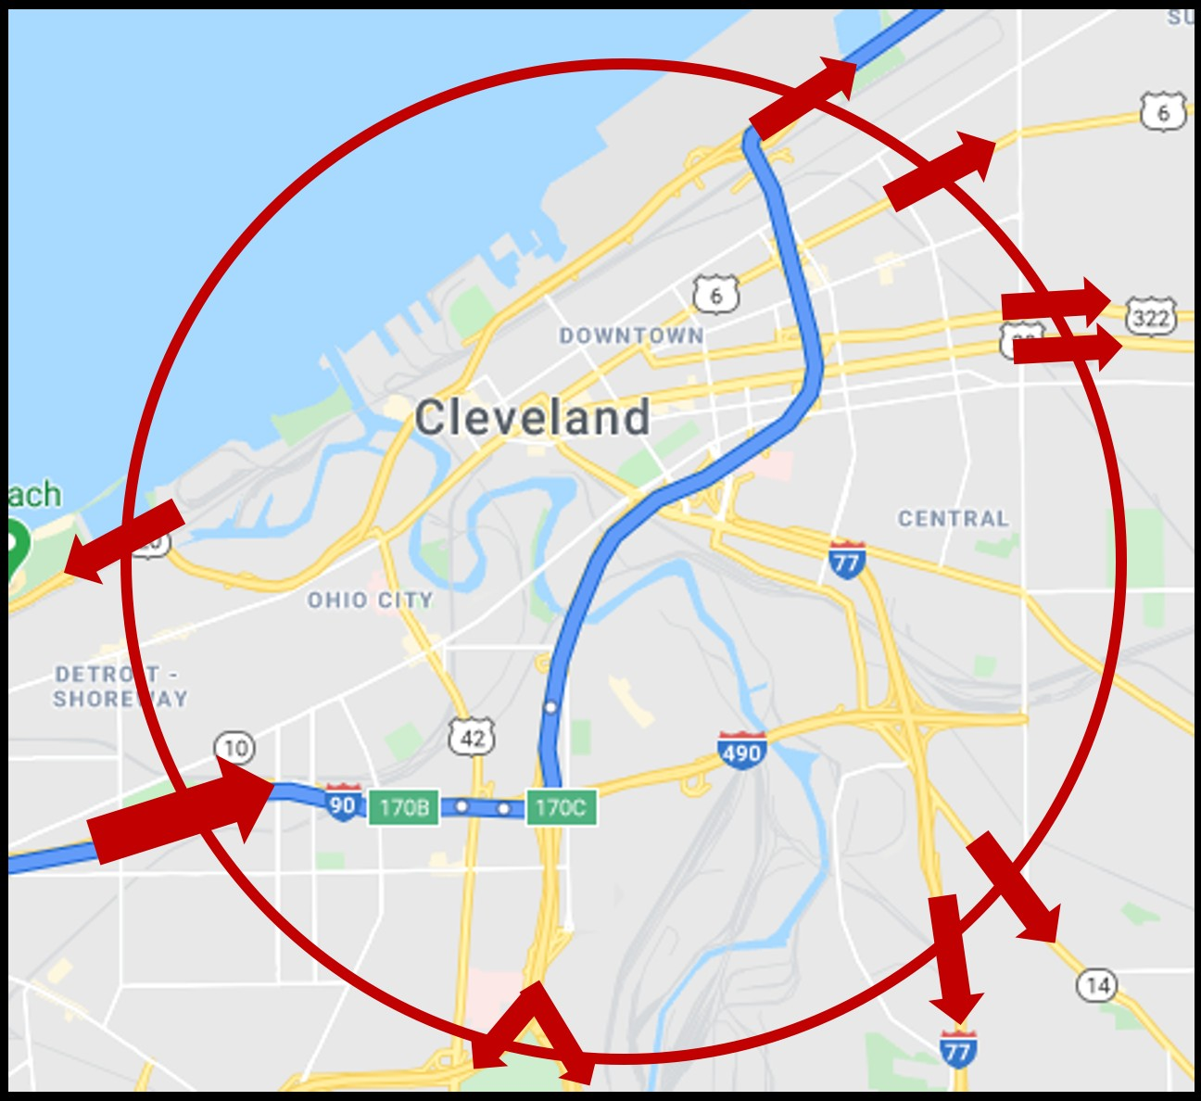
forwarding
forwarding

Slide 14







Packet delay: four sources
transmission
A
propagation
B
nodal
processing queueing
^{d}nodal ^{= d}proc ^{+ d}queue ^{+ d}trans ^{+ d}prop
d_{proc}: nodal processing
check bit errors
determine output link
typically < microsecs
d_{queue}: queueing delay
time waiting at output link for transmission
depends on congestion level of router

Slide 15



Packet delay: four sources
transmission
A
propagation
B
nodal
processing queueing
^{d}nodal ^{= d}proc ^{+ d}queue ^{+ d}trans ^{+ d}prop
d_{trans}: transmission delay:
L: packet length (bits)
R: link transmission rate (bps)
d_{trans} = L/R
d_{prop}: propagation delay:
d: length of physical link
s: propagation speed (~2x10⁸ m/sec)
d_{prop} = d/s
d and d
trans prop
very different

Slide 16

Protocol stack
NT101 – Network Security

Slide 17
Why layering?
Approach to designing/discussing complex systems:
explicit structure allows identification, relationship of system’s pieces
layered reference model for discussion
modularization eases maintenance, updating of system
change in layer's service implementation: transparent to rest of system
e.g., change in gate procedure doesn’t affect rest of system

Slide 18

Layered Internet protocol stack
application: supporting network applications
HTTP, IMAP, SMTP, DNS
transport: process-process data transfer
TCP, UDP
network: routing of datagrams from source to destination
IP, routing protocols
link: data transfer between neighboring network elements
Ethernet, 802.11 (WiFi), PPP
physical: bits “on the wire”
application
transport
network
link
physical
application
transport
network
link
physical

Slide 19








Services, Layering and Encapsulation
application
transport
network
link
physical
M
application
transport
network
link
physical
Application exchanges messages to implement some application service using services of transport layer
H_{t} M
Transport-layer protocol transfers M (e.g., reliably) from one process to another, using services of network layer
transport-layer protocol encapsulates application-layer message, M, with transport layer-layer header H_{t} to create a transport-layer segment
H_{t} used by transport layer protocol to implement its service
source
destination

Slide 20




Services, Layering and Encapsulation
application
transport
network
link
physical
M
application
transport
network
link
physical
H_{t} M
Transport-layer protocol transfers M (e.g., reliably) from one process to another, using services of network layer
Hn H_{t} M
Network-layer protocol transfers transport-layer segment [H_{t} | M] from one host to another, using link layer services
network-layer protocol encapsulates transport-layer segment [H_{t} | M] with network layer-layer header H_{n} to create a network-layer datagram
H_{n} used by network layer protocol to implement its service
source
destination

Slide 21




Services, Layering and Encapsulation
application
transport
network
link
physical
M
application
transport
network
link
physical
H_{t}
M
Hn H_{t} M
Network-layer protocol transfers transport-layer segment [H_{t} | M] from one host to another, using link layer services
H_{l} | H_{n} | H_{t} | M
Link-layer protocol transfers datagram [H_{n}| [H_{t} |M] from
host to neighboring host, using network-layer services
link-layer protocol encapsulates network datagram [H_{n}| [H_{t} |M], with link-layer header H_{l} to create a link-layer frame
source
destination

Slide 22




Services, Layering and Encapsulation
application
transport
network
link
physical
M
application
transport
network
link
physical
M
message
H_{t}
M
H_{t} M
segment
H_{n} | H_{t} | M
H_{n} H_{t}
M
datagram
frame
H_{l} | H_{n} | H_{t} | M
H_{l} | H_{n} | H_{t} | M
source
destination

Slide 23










Encapsulation: an end-end view
source
application
message
M
segment
H_{t}
M
transport network
H_{t}
datagram
H_{n} H_{t}
M
H_{n}
frame
H_{l}
H_{n} H_{t} M
link physical
link physical
switch
destination
H_{n} | H_{t} | M
network
M
application
transport
network
link
physical
H_{l} | H_{n} | H_{t} | M
link physical
H_{n}
H_{t}
M
H_{t}
M
 | H_{n} | H_{t} | M
H_{l} | H_{n} | H_{t} | M
router

Slide 24
ISO/OSI reference model
Two layers not found in Internet protocol stack!
presentation: allow applications to interpret meaning of data, e.g., encryption, compression, machine-specific conventions
session: synchronization, checkpointing, recovery of data exchange
Internet stack “missing” these layers!
these services, if needed, must be implemented in application
needed?
application
presentation
session
transport
network
link
physical
The seven layer OSI/ISO reference model

Slide 25

Network Security
At a glance

Slide 26
Network security
Internet not originally designed with (much) security in mind
original vision: “a group of mutually trusting users attached to a transparent network” ☺
Internet protocol designers playing “catch-up”
security considerations in all layers!
We now need to think about:
how bad guys can attack computer networks
how we can defend networks against attacks
how to design architectures that are immune to attacks

Slide 27
What is network security?
confidentiality: only sender, intended receiver should “understand” message contents
sender encrypts message
receiver decrypts message
authentication: sender, receiver want to confirm identity of each other
message integrity: sender, receiver want to ensure message not altered (in transit, or afterwards) without detection
access and availability: services must be accessible and available to users

Slide 28







Friends and enemies: Alice, Bob, Trudy
well-known in network security world
Bob, Alice (lovers!) want to communicate “securely”
Trudy (intruder) may intercept, delete, modify/add messages
Alice
_{channel} data, control
Bob
messages
secure sender
secure
receiver
data
data
Trudy

Slide 29
Friends and enemies: Alice, Bob, Trudy
Who might Bob and Alice be?
… well, real-life Bobs and Alices!
Web browser/server for electronic transactions (e.g., on-line purchases)
on-line banking client/server
DNS servers
BGP routers exchanging routing table updates
other examples?

Slide 30
There are bad guys (and girls) out there!
Q: What can a “bad guy” do?
A: A lot!
eavesdrop: intercept messages
actively insert messages into connection
impersonation: can fake (spoof) source address in packet (or any field in packet)
hijacking: “take over” ongoing connection by removing sender or receiver, inserting himself in place
denial of service: prevent service from being used by others (e.g., by overloading resources)

Slide 31







Bad guys: packet interception
packet “sniffing”:
broadcast media (shared Ethernet, wireless)
promiscuous network interface reads/records all packets (e.g., including passwords!) passing by
A
C
src:B dest:A
payload
B
Wireshark software used for our end-of-chapter labs is a (free) packet-sniffer Alternatives: tcpdump, scapy,…

Slide 32





Bad guys: fake identity
IP spoofing: injection of packet with false source address
A
C
src:B
dest:A
payload
B
→ Looking ahead: More deeply analysis of Sniffing and Spoofing in the next lecture

Slide 33





















Bad guys: denial of service
Denial of Service (DoS): attackers make resources (server, bandwidth) unavailable to legitimate traffic by overwhelming resource with bogus traffic
1. select target
break into hosts around the network (see botnet)
send packets to target
from compromised hosts
target

Slide 34
Lines of defense:
authentication: proving you are who you say you are
cellular networks provides hardware identity via SIM card; no such hardware assist in traditional Internet
confidentiality: via encryption
integrity checks: digital signatures prevent/detect tampering
access restrictions: password-protected VPNs
firewalls: specialized “middleboxes” in access and core networks:
off-by-default: filter incoming packets to restrict senders, receivers, applications
detecting/reacting to DOS attacks
→ lots more on network defense (throughout Lecture 11)

Slide 35

For next time…
Looking ahead
Ready for next class:
Tentative topic: Packet Sniffing and Spoofing
Reading and practicing (in advance):
SEED book, Chapter 15
Refs: https://www.handsonsecurity.net/resources.html
SEED Lab: Packet Sniffing and Spoofing Lab
Refs: https://seedsecuritylabs.org/Labs_16.04/Networking/Sniffing_Spoofing/
NT101 – Network Security
Winter 2020
38

Slide 36
Authentication: a case study
Goal: Bob wants Alice to “prove” her identity to him Protocol ap1.0: Alice says “I am Alice”
“I am Alice”
failure scenario??

Slide 37
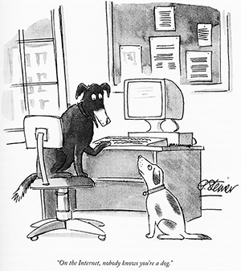
Authentication: issues
Goal: Bob wants Alice to “prove” her identity to him Protocol ap1.0: Alice says “I am Alice”
in a network, Bob can not “see” Alice, so Trudy simply declares herself to be Alice
“I am Alice”

Slide 38

Authentication: another try
Goal: Bob wants Alice to “prove” her identity to him
Protocol ap2.0: Alice says “I am Alice” in an IP packet containing her source IP address
Alice’s IP address
“I am Alice”
failure scenario??

Slide 39

Authentication: another try
Goal: Bob wants Alice to “prove” her identity to him
Protocol ap2.0: Alice says “I am Alice” in an IP packet containing her source IP address
Trudy can create a packet “spoofing”
Alice’s address
Alice’s IP address
“I am Alice”

Slide 40


Authentication: a third try
Goal: Bob wants Alice to “prove” her identity to him
Protocol ap3.0: Alice says “I am Alice” Alice says “I am Alice” and sends her secret password to “prove” it.
failure scenario??
Alice’s IP addr | Alice’s password | “I am Alice”
Alice’s IP addr
OK

Slide 41



Authentication: a third try
Goal: Bob wants Alice to “prove” her identity to him
Protocol ap3.0: Alice says “I am Alice” Alice says “I am Alice” and sends her secret password to “prove” it.
replay attack: Trudy records Alice’s packet and later
plays it back to Bob
Alice’s IP addr | Alice’s password | “I am Alice”
“I am Alice”
Alice’s
OK
Alice’s
password
Alice’s
IP addr
IP addr

Slide 42
Authentication: a modified third try
Goal: Bob wants Alice to “prove” her identity to him
Protocol ap3.0: Alice says “I am Alice” Alice says “I am Alice” and sends her encrypted secret password to “prove” it.
failure scenario??
Alice’s IP addr | encrypted password | “I am Alice”
Alice’s IP addr
OK

Slide 43
Authentication: a modified third try
Goal: Bob wants Alice to “prove” her identity to him
Protocol ap3.0: Alice says “I am Alice” Alice says “I am Alice” and sends her encrypted secret password to “prove” it.
replay attack still works: Trudy records Alice’s packet
and later plays it back to Bob
Alice’s IP addr | encrypted password | “I am Alice”
“I am Alice”
encrypted
OK
Alice’s
password
Alice’s
IP addr
IP addr

Slide 44
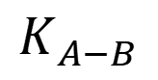
Authentication: a fourth try
Goal: avoid replay attack
nonce: number (R) used only once-in-a-lifetime
protocol ap4.0: to prove Alice “live”, Bob sends Alice nonce, R
Alice must return R, encrypted with shared secret key
“I am Alice”
R
Bob know Alice is live, and
$$K_{A−B}$$
$$K_{A−B}$$
K_{A-B}(R)
only Alice knows key to encrypt nonce, so it must be Alice!
Failures, drawbacks?

Slide 45
Authentication: ap5.0
ap4.0 requires shared symmetric key - can we authenticate using public key techniques?
ap5.0: use nonce, public key cryptography
“I am Alice”
^{Public key / secret key}
R
K⁻ /K⁺
-
K_{A} (R)
Send me your public key
Bob computes
K⁺
_{K} +
-
A
_{A} (K_{A}(R)) = R’ ?= R

Slide 46
Authentication: ap5.0 – there’s still a flaw!
man (or woman) in the middle attack: Trudy poses as Alice (to Bob) and as Bob (to Alice)
I am Alice
I am Alice
?
R₋
K _{T}(R)
R
Where are
Send me your public key
K ⁻ (R)
mistakes
_{K}+
A
made here?
T
Bob computes
Send me your public key
K_{A}
+ -
K (K _{T}(R)) = R,
+
T
authenticating Trudy as Alice
Trudy recovers m:
+
Trudy recovers Bob’s m:
+
- +
K (m)
m = K (K _{T}(m))
T
Bob sends a personal message, m to Alice
m = K⁻ (K⁺(m))
K_{A}(m)
T
A
A
sends m to Alice encrypted with Alice’s public key
and she and Bob meet a week later in person and discuss m, not knowing Trudy knows m

Slide 47
Authentication: modified ap5.0
ap4.0 requires shared symmetric key - can we authenticate using public key techniques?
ap5.0: use nonce, public key cryptography
“I am Alice”
Bob know Alice’s public key:
K⁺
^{Public key / secret key}
R
K⁻ /K⁺
-
Bob computes
K_{A} (R)
_{K} +
-
_{A} (K_{A}(R)) = R’ ?= R
How ditribute Alice’s public?

Slide 48

Need for certified public keys
motivation: Trudy plays pizza prank on Bob
Trudy creates e-mail order:
Dear Pizza Store, Please deliver to me four pepperoni pizzas. Thank you, Bob
Trudy signs order with her private key
Trudy sends order to Pizza Store
Trudy sends to Pizza Store her public key, but says it’s Bob’s public key
Pizza Store verifies signature; then delivers four pepperoni pizzas to Bob
Bob doesn’t even like pepperoni

Slide 49




Public key Certification Authorities (CA)
certification authority (CA): binds public key to particular entity, E
entity (person, website, router) registers its public key with CE provides “proof of identity” to CA
CA creates certificate binding identity E to E’s public key
certificate containing E’s public key digitally signed by CA: CA says “this is E’s public key”
Bob’s
digital signature (encrypt)
public
+
+
key K_{B}
K_{B}
CA’s
certificate for Bob’s public key, signed by CA
private _{K} -
Bob’s identifying information
key
CA

Slide 50




Public key Certification Authorities (CA)
when Alice wants Bob’s public key:
gets Bob’s certificate (Bob or elsewhere)
apply CA’s public key to Bobʼs certificate, get Bob’s public key
digital signature (decrypt)
Bob’s public key
+
K_{B}
+
K _{B}
CA’s
public _{K}+
key
CA

